Slide 1
Supervised Machine Learning Capstone Project
US Census Income Data (1994 – 1995)

Slide 2
Content
Background
Problem Statement
Data Set
Analytical Questions
Exploratory Data Analysis
Data Manipulation
Data Visualization
Machine Learning Models
Model Evaluation
Final Thoughts

Slide 3
Background
The prominent inequality of income continues to be a pressing problem especially in the United States despite federal laws protecting against pay discrimination by race, ethnicity, and gender.
The principle of universal moral equality ensures sustainable development and improve the economic stability of a nation.

Slide 4
Problem Statement
“Given various features, the aim is to build a predictive model to determine the income level for people in US. The income levels are binned at below 50K and above 50K.”

Slide 5
Data Set
UCI Census Income Dataset has been used for the purpose.
This data set contains weighted census data extracted from the 1994 and 1995 current population surveys conducted by the U.S. Census Bureau.
Classification has been done to predict whether a person's annual income in US falls in the income category of either greater than 50K Dollars or less equal to 50K Dollars category based on a certain set of demographic and employment related attributes.

Slide 6
Analytical Questions
What features, within the provided dataset, are most determinant of a project's success or failure?
Which prediction models or algorithms perform best in terms of speed, accuracy, and explainability combined?
How good is our trained model in predicting future projects?

Slide 7
Exploratory Data Analysis
Basic statistics for this data set
Number of instances in data = 199523
Duplicate or conflicting instances : 46627
Number of attributes = 40 (continuous : 7 nominal : 33)
Target variable = "Income Level” binned at the $50K level (binary classification problem).
Train-Test-Split
The data was split into train/test in 2/3 and 1/3 proportions.

Slide 8
Data Manipulation
The values represented by 'Not in universe', 'Not in universe or children' and 'Not in universe under 1 year old' are replaced by unknown.
Education, Marital Status, Class Of Worker and Tax Filer Status is classified in multiple similar categories.
Since Migration type Features are missing 50% values and are deleted.
Country type Features have been filled with the mode values.
Observations with education = “Children”, capital gains = 99999 and age = 90 are deleted.

Slide 9
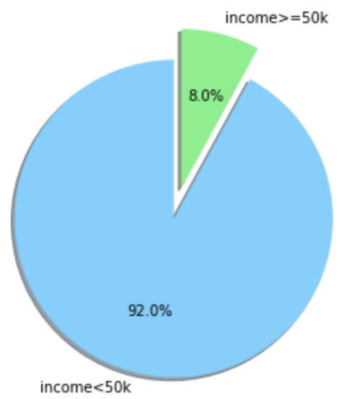
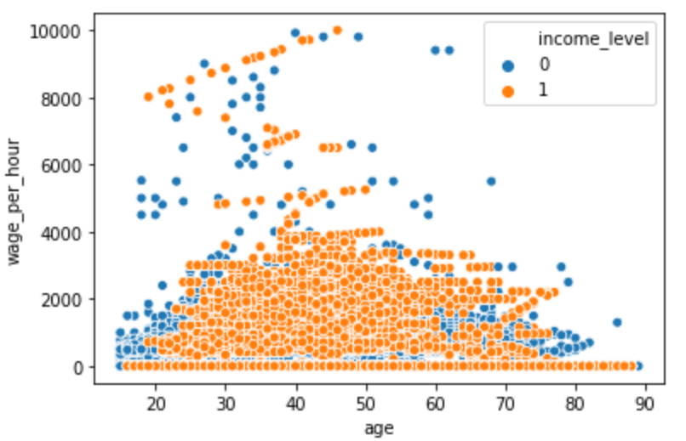
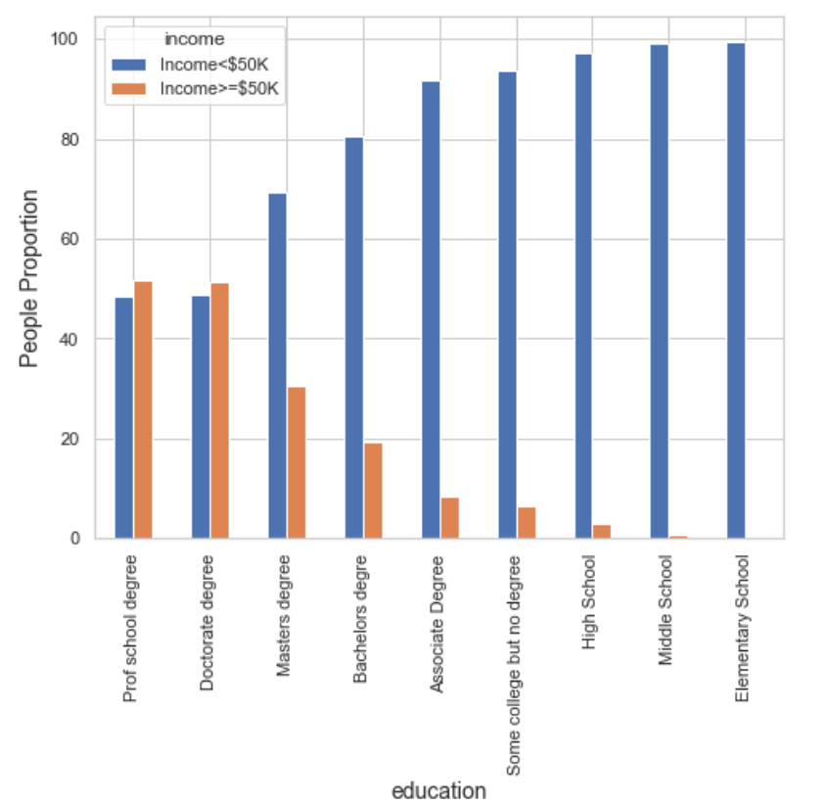
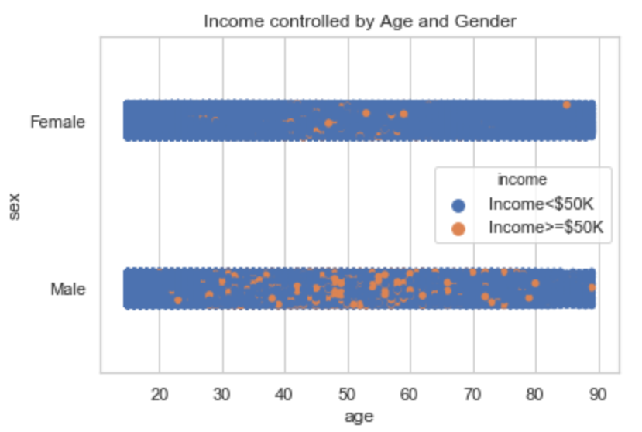
Data Visualizations
92% have income less than 50K and 8% have income greater than 50K
White and Asian-pacific-Islanders earn salary more than 50K
Greater distribution of income>50k among males between age 30 – 65, and moderate distribution of income>50k among females between age 45 – 60 gender pay gap.
Doctorate, Professional School, and Masters degree holders are making salary more than 50K.

Slide 10
Machine Learning Models
Preprocess and Transform the data set.
Use SMOTE to balance the data set.
Split the data set between Training data set and Test data set at 67% and 33% proportions.
Explore and Evaluate various ML Algorithms.
Interpret and Report results.
Refine and Improve the results by tuning hyper parameters.
Logistic Regression
K- Nearest Neighbors
Decision Trees
Random Forest
Extra Trees
Gradient Boost
ADA Boost
Bagging
SVM
Naïve Bayes
ML Algorithms

Slide 11
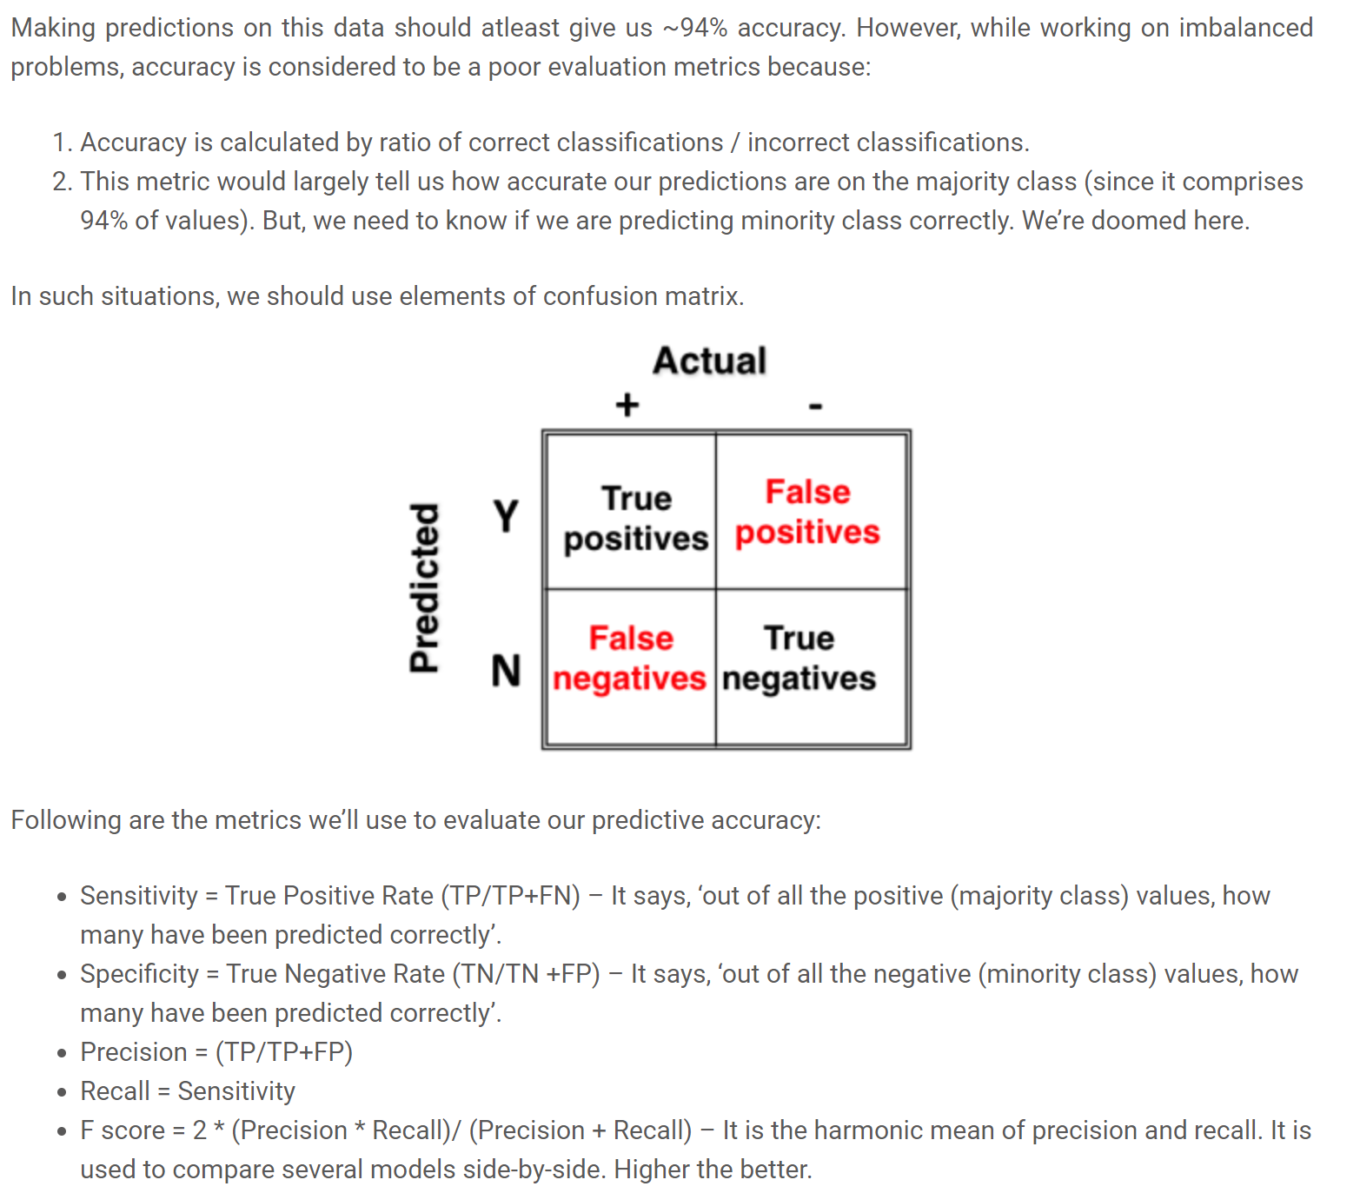
Model Evaluation

Slide 12
Model Evaluation – Unbalanced Data
MODEL/METRIC | Accuracy | Sensitivity | Specificity | FP Rate | Precision | F-Score | Time Taken
Gradient Boosting | 94.12% | 39.43% | 98.81% | 1.19% | 74.03% | 51.45% | 1m:44s
Logistic Regression | 93.72% | 35.75% | 98.70% | 1.30% | 70.20% | 47.37% | 0m:06s
ADA Boost | 93.72% | 34.07% | 98.84% | 1.16% | 71.57% | 46.16% | 0m:25s
Bagging | 93.58% | 40.13% | 98.16% | 1.84% | 65.25% | 49.70% | 1m:02s
Random Forest | 93.49% | 32.80% | 98.70% | 1.30% | 68.46% | 44.35% | 0m:05s
Extra Trees | 92.97% | 31.99% | 98.21% | 1.79% | 60.56% | 41.87% | 0m:08s
KNN | 92.51% | 28.54% | 98.01% | 1.99% | 55.15% | 37.62% | 16m:03s
SVM | 92.10% | 0.10% | 100.00% | 0.00% | 100.00% | 0.20% | 19m:35s
Decision Tree | 91.45% | 47.44% | 95.22% | 4.78% | 46.03% | 46.73% | 00:11s
Naïve Bayes | 34.82% | 95.18% | 29.63% | 70.37% | 10.41% | 18.76% | 00:01s

Slide 13
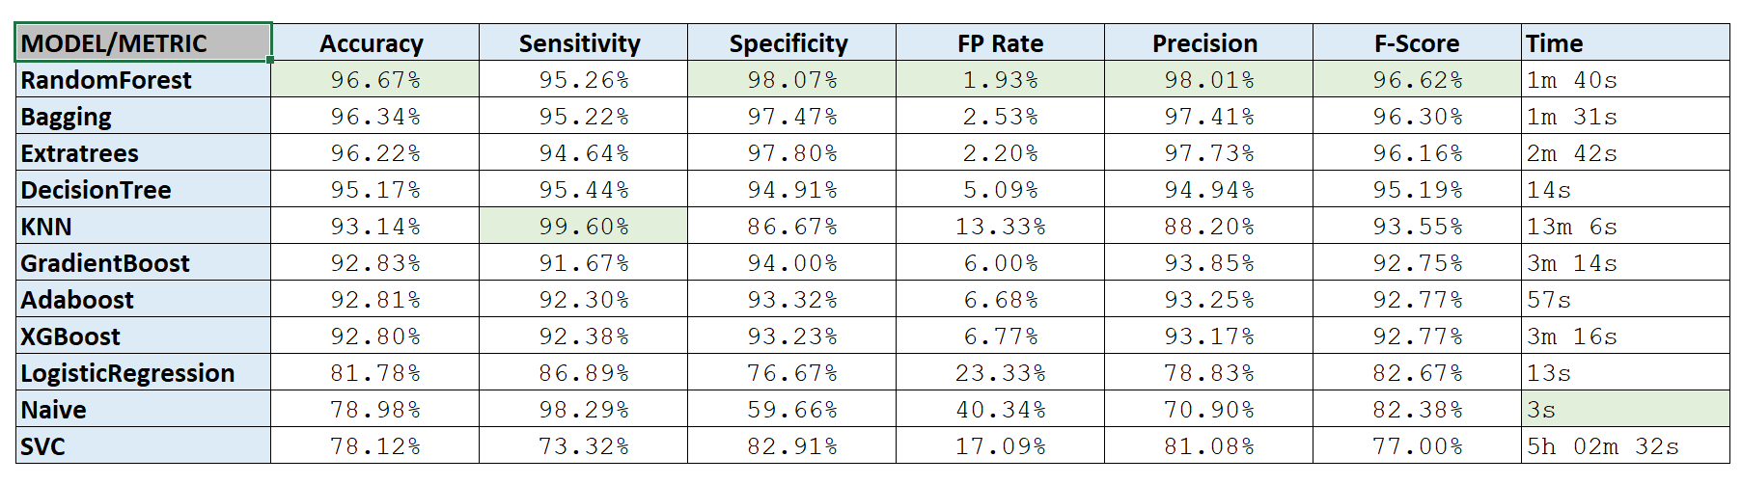
Model Evaluation – SMOTE

Slide 14
Final Thoughts
Conclusions
After comparing the model performance using the confusion matrix and accuracy of the model, we can certainly say that the Random Forest model is better fit to predict the income of an individual based on the census data.
Practical Uses
Establish structures, policies, objectives in every organization to ensure gender balance
This analysis can be useful to the banks or other financial institutes to know the american salary distribution and target potential borrowers and segment them appropriately
Future Considerations
May consider doing additional analysis that focuses on dimension reduction such as Prinicipal Component Analysis (PCA) or Linear Discriminant Analysis (LDA). Since this data set represents classification problem, LDA can be used as a preprocessing step in Machine Learning and pattern classification applications.

Slide 15
Q&A

